Slide 1
EE227 – Digital Logic Design
Lecture 19 – 20

Slide 2
Outline
Flip Flops
D – Flip Flop
JK Flip Flop
T – Flip Flop
Quiz 3 Solution
Code Conversion Combinational Circuit
Quiz 4
Quiz 4 Solution

Slide 3
Latch and Flip Flop
Latches
Storage elements that operate with signal levels are referred to as latches
Flip Flops
Storage elements that are controlled by a clock transition are flip-flops

Slide 4
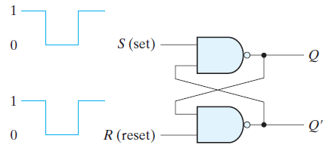
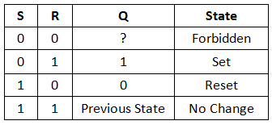
SR Latch

Slide 5
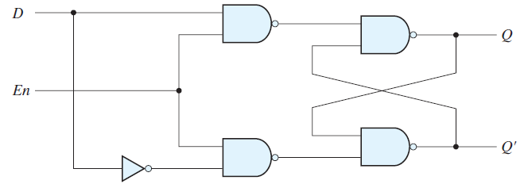
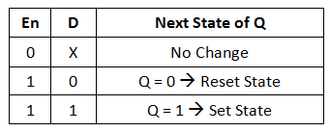
D Latch

Slide 6
Conversion of D Latch to Flip Flop
The state of a latch or flip-flop is switched by a change in the control input
This momentary change is called a trigger, and the transition it causes is said to trigger the flip-flop
The D latch with pulses in its control input is essentially a flip-flop that is triggered every time the pulse goes to the logic-1 level
As long as the pulse input remains at this level, any changes in the data input will change the output and the state of the latch

Slide 7
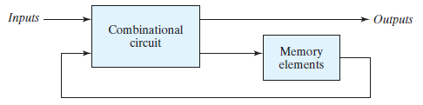
Problem with using Latches in Sequential Circuits (1/2)
In a sequential circuit the inputs of the flip-flops are derived in part from the outputs of the same and other flip-flops
The state transitions of the latches start as soon as the clock pulse changes to the logic-1 level
The new state of a latch appears at the output while the pulse is still active
If the inputs applied to the latches change while the clock pulse is still at the logic-1 level, the latches will respond to new values and a new output state may occur
The result is an unpredictable situation

Slide 8
Problem with using Latches in Sequential Circuits (2/2)
If the inputs applied to the latches change while the clock pulse is still at the logic-1 level, the latches will respond to new values and a new output state may occur
The result is an unpredictable situation
Because of this unreliable operation, the output of a latch cannot be applied directly or through combinational logic to the input of the same or another latch when all the latches are triggered by a common clock source

Slide 9

Flip Flops (1/3)
Flip-flop circuits are constructed in such a way as to make them operate properly when they are part of a sequential circuit that employs a common clock
The problem with the latch is that it responds to a change in the level of a clock pulse

Slide 10


Flip Flops (2/3)
The key to the proper operation of a flip-flop is to trigger it only during a signal transition
A clock pulse goes through two transitions:
From 0 to 1
Positive edge transition
From 1 to 0
Negative edge transition

Slide 11
Flip Flops (3/3)
There are two ways that a latch can be modified to form a flip-flop
One way is to employ two latches in a special configuration that isolates the output of the flip-flop and prevents it from being affected while the input to the flip-flop is changing
Another way is to produce a flip-flop that triggers only during a signal transition (from 0 to 1 or from 1 to 0) of the synchronizing signal (clock) and is disabled during the rest of the clock pulse

Slide 12
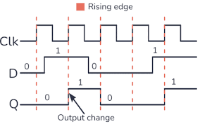
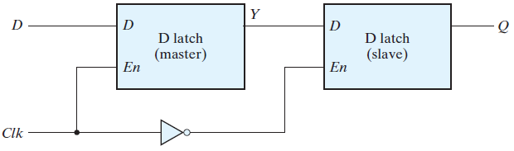

Edge Triggered D – Flip Flop with D Latches
Master – Slave Configuration
A change in the output of the flip-flop can be triggered only by and during the transition of the clock from 1 to 0

Slide 13
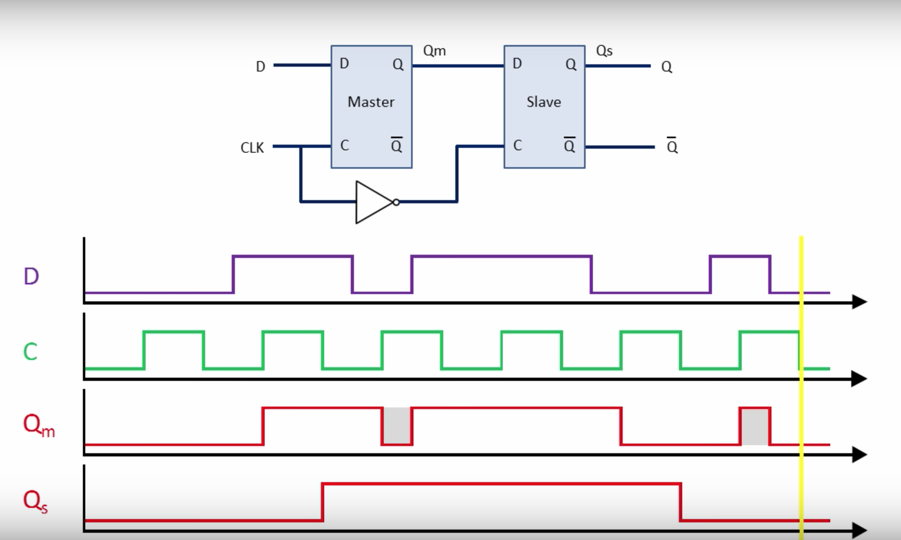
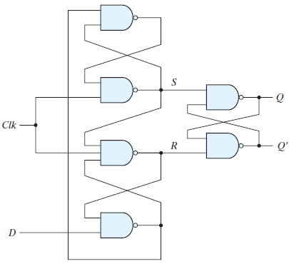
Edge Triggered D – Flip Flop with SR Latches
When Clk = 0
R = 1, S = 1
No change in state
When D = 0 and Clk changes from 0 to 1
R = 0, S = 1 → Q = 0
Reset state
Further change in D when Clk = 1
Locked state as R = 0
When D = 1 and Clk changes from 0 to 1
S = 0, R = 1 → Q = 1
Set State

Slide 14
Setup, Hold and Propagation Delay Time
There is a minimum time called the setup time during which the D input must be maintained at a constant value prior to the occurrence of the clock transition
There is a minimum time called the hold time during which the D input must not change after the application of the positive transition of the clock
The propagation delay time of the flip-flop is defined as the interval between the trigger edge and the stabilization of the output to a new state

Slide 15
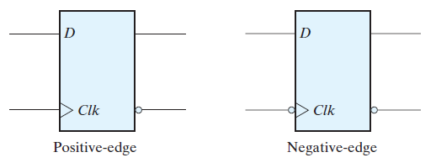
Graphical Symbols of D – Flip Flop
The dynamic indicator (>) denotes the fact that the flip-flop responds to the edge transition of the clock

Slide 16
Other Flip Flops
There are three operations that can be performed with a flip-flop
Set it to 1
Reset it to 0
Complement its output
With only a single input, the D flip-flop can set or reset the output
There are two other flip flops
JK flip flop
T flip flop

Slide 17
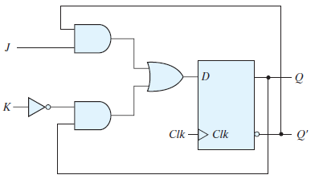
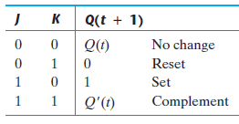
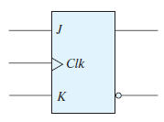
JK Flip Flop
2 inputs J and K
Performs all 3 operations
D = JQ’ + K’Q

Slide 18

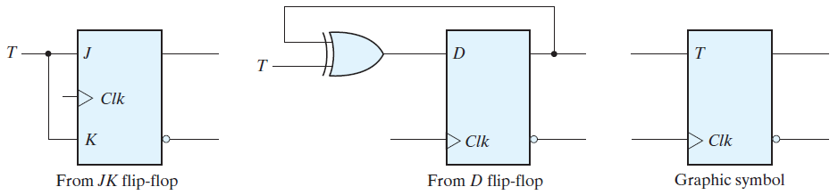
Toggle (T) – Flip Flop
The T (toggle) flip-flop is a complementing flip-flop and can be obtained from a JK flip-flop when inputs J and K are tied together
The T flip-flop can be constructed with a D flip-flop and an exclusive-OR gate as
D = T ⊕ Q = TQ’ + T’Q

Slide 19
Characteristic Equations
The next state [Q(t + 1)] can be obtained with the help of characteristic equations
For D – Flip Flop
Q(t + 1) = D
For JK Flip Flop
Q(t + 1) = JQ’ + K’Q
For T – Flip Flop
Q(t + 1) = T ⊕ Q = TQ’ + T’Q

Slide 20
Direct Inputs in Flip Flops
Some flip-flops have asynchronous inputs that are used to force the flip-flop to a particular state independently of the clock
The input that sets the flip-flop to 1 is called preset or direct set
The input that clears the flip-flop to 0 is called clear or direct reset

Slide 21
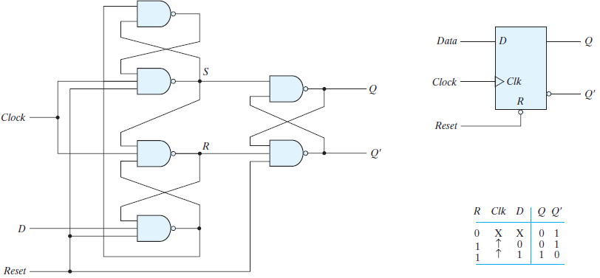
Edge Triggered D Flip Flop with Direct Reset

Slide 22
Code Conversion Combinational Circuit
Missed Topic from Chapter 4

Slide 23
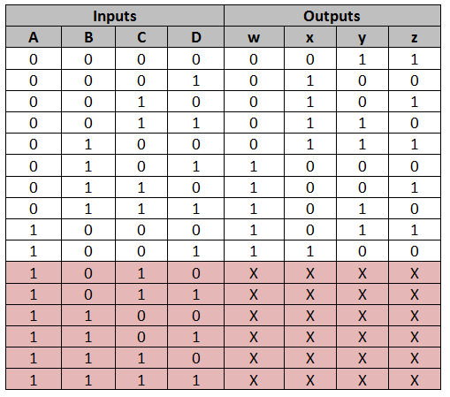
BCD to Excess – 3 Code Conversion (1/4)
Truth Table

Slide 24
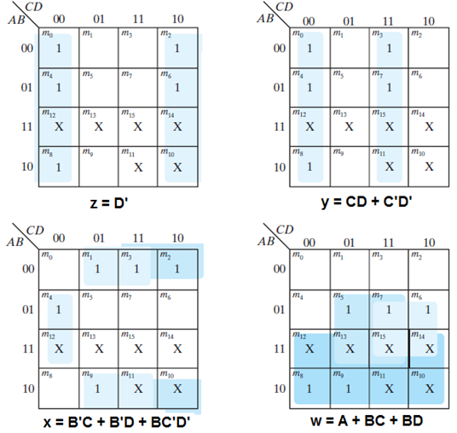
BCD to Excess – 3 Code Conversion (2/4)
K – Map Simplification

Slide 25
BCD to Excess – 3 Code Conversion (3/4)
Boolean Equations
z = D’
y = CD + C’D’
y = CD + (C + D)’
x = B’C + B’D + BC’D’
x = B’(C + D) + BC’D’
x = B’(C + D) + B(C + D)’
w = A + BC + BD
w = A + B(C + D)

Slide 26
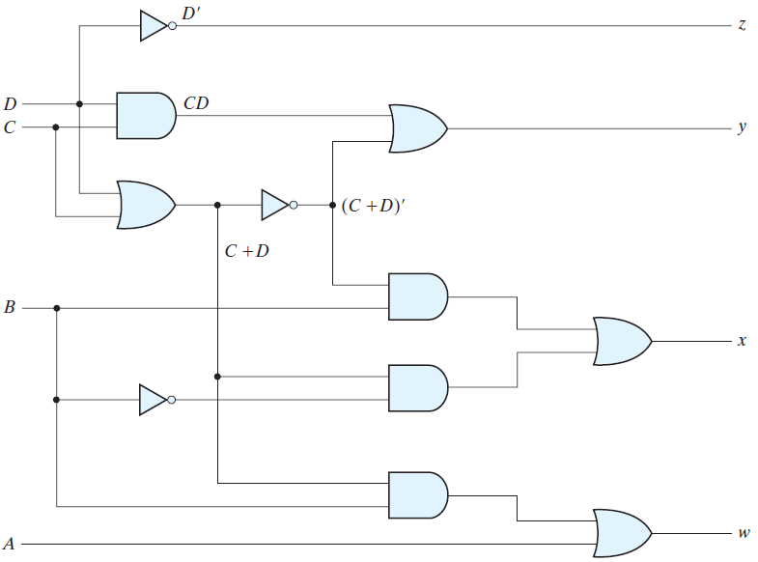
BCD to Excess – 3 Code Conversion (4/4)
Circuit Diagram

Slide 27
Quiz 3 and 4
Solution
Was Done in Class

